Slide 1
Introduction To Version Control
Dr. David Jameson
November 18th, 2013
Social Programming

Slide 2
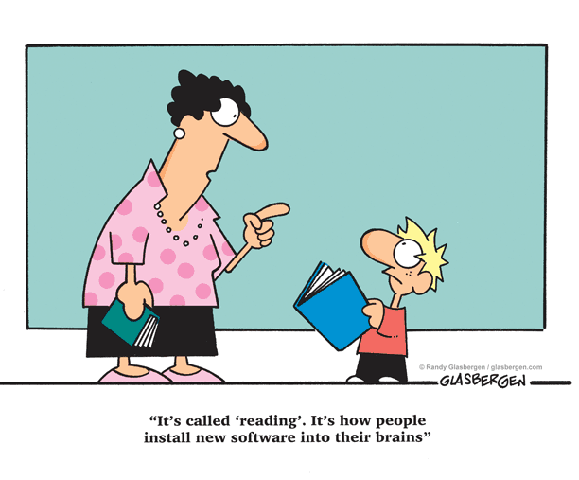
Notes:
Lots of great books and tutorials to be found

Slide 3
http://git-scm.com/book
Notes:
Lots of great books and tutorials to be found

Slide 4
Why version control?
Track all changes over time
For individuals and teams
Good for programming, documents, images, websites, …
Anything that can change over time
(Including this presentation!)
Find out what happened in the past
Revert to earlier versions in case of mistakes
The mother of all undo!
Collaboration – share changes
History review helps to understand the project evolution
Code review

Slide 5
Two basic kinds of VCS*
Centralized
RCS
Subversion (SVN)
ClearCase
VSS
Distributed
Git
Mercurial

Slide 6
Two basic approaches
Exclusive file access (locking)
User checks out files to modify
Nobody else can change them until they are checked in again
Merge model
Multiple users can edit the same files
Changes must be merged back into the system

Slide 7
Why Git?
Local history – no dependency on remote server
Fast (mostly because of 1)
Lightweight branching
Non-linear development
Easy to do experiments
Extremely popular and well supported
GitHub, etc

Slide 8
Important terms
Repository (repo)
Working copy (working tree, working directory)
Changesets
Collections of files
Checkout
Diff
Staging (index, cache)
Commits
Branching (Forking)
Merging
Ignore
Cloning

Slide 9
Command line vs GUI
Git is historically a command line program with a gazillion* options
I don’t like learning stuff that I don’t need to know!
(Hmmm, how do I figure out what I don’t need to know?)
Decent GUI apps ease the learning curve
Good tools hold your hand but don’t get in your way
Defer advanced stuff until you need it
*Important technical term

Slide 10
Getting started with SourceTree
Bookmarks (not part of Git)
A way to keep track of all repos on your machine
Also this is where you can
Create repository
Clone repository
Add working copy

Slide 11
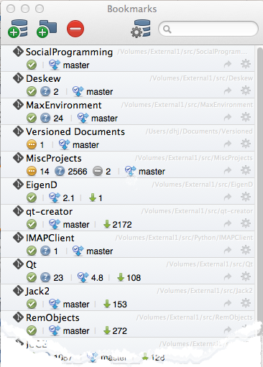
Notes:
Private projects, team projects, open source projects pulled from GitHub

Slide 12
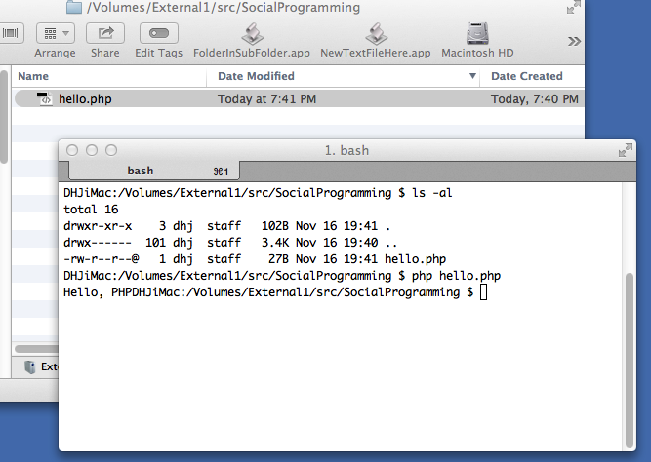
Create new repo for existing code
Notes:
Here’s the folder where we had already created some code

Slide 13
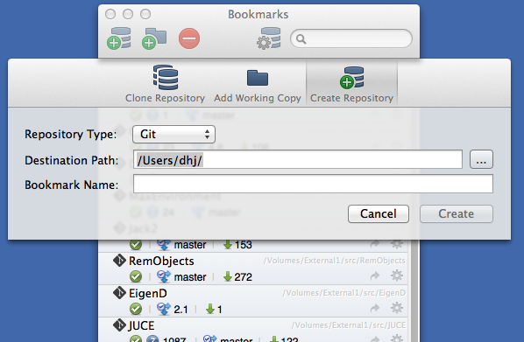
Notes:
Click on Create Repository

Slide 14
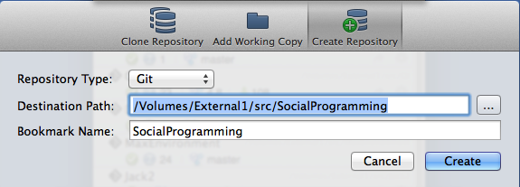
Notes:
Define where we will store the repository and give it a bookmark name. In this example, it’s the top level folder where we have our code or document

Slide 15
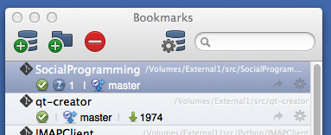
What happened?
Notes:
New repo added to bookmark list

Slide 16
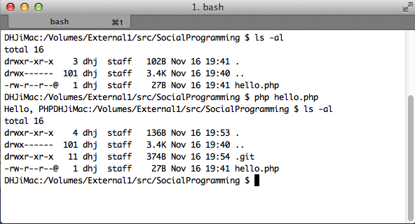
What happened?
Notes:
Oh, look ---- a hidden folder got created

Slide 17
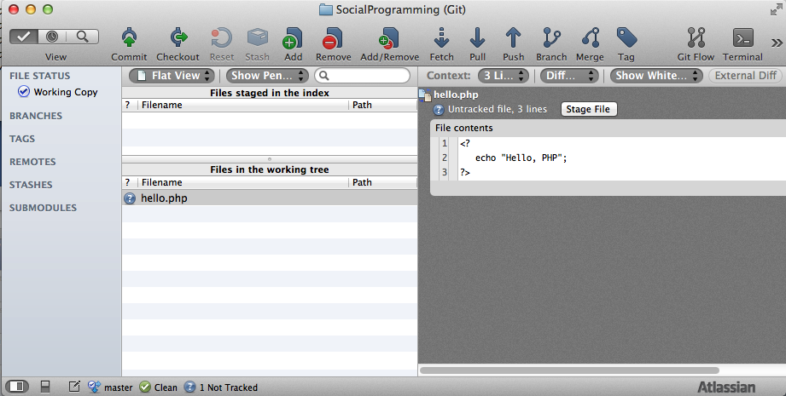

Slide 18
Notes:
Untracked files means that Git doesn’t know about them. Note that there are some files (like compiled object files) that you will never want to track. The Git Ignore mechanism is used for such things

Slide 19
Commits and staging
Commit
Saves your changed files into the repository
Typically commit all changed files in one go
Staging (introduced in Git)
Allows you to lock in a change but doesn’t commit
You can collect your changed files over time to create the group of files that are to be committed

Slide 20
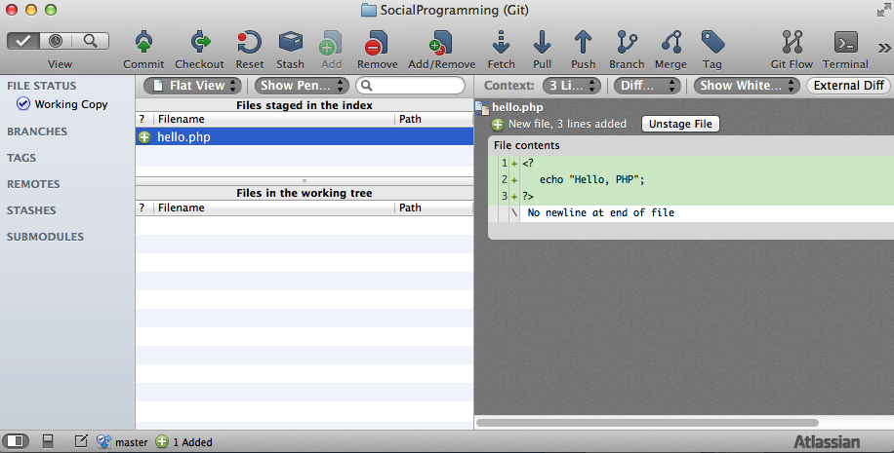
Notes:
We add our file to the staging area. We can still undo this – the diff shows what has changed, i.e. a new file with three lines added

Slide 21
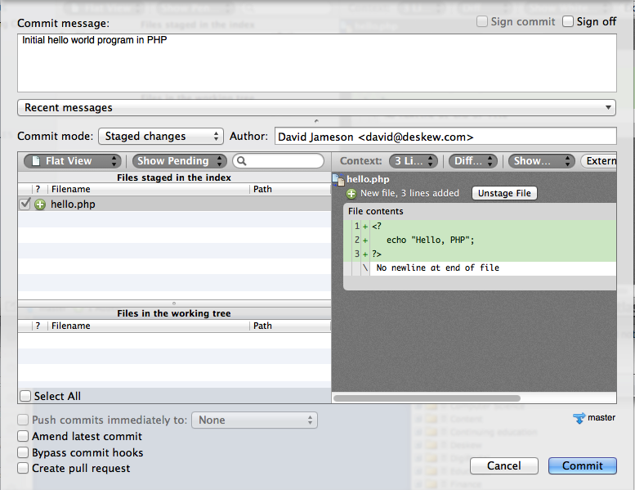
Preparing to commit
Notes:
Comments are very important because you can search history. Comments should explain what you did (fixed something, added new feature, etc) and why you did it. Comments should not contain actual code changes as those can be seen through ‘diff’

Slide 22
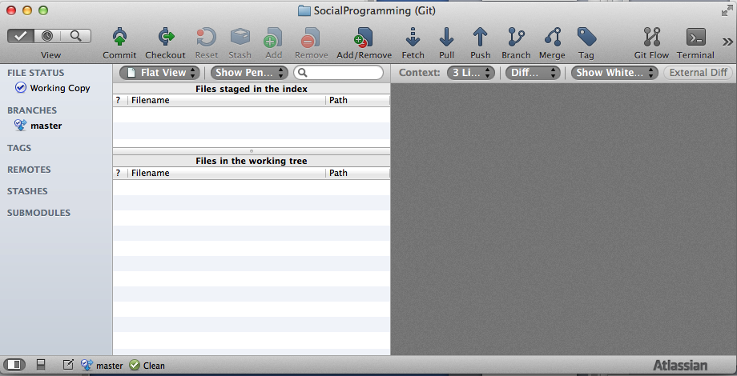
Notes:
What happened? There’s nothing there any more.

Slide 23
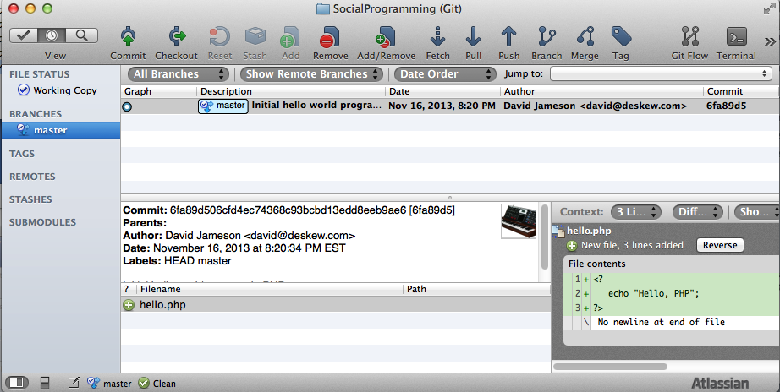

Slide 24
What gets saved?
The changed files (duh!)
Meta data
Person who made the changes
Date of the changes
Comments about the changes

Slide 25
Let’s make a change
Oops, there should be a new line after “Hello, PHP”
We edit the file to fix this problem

Slide 26
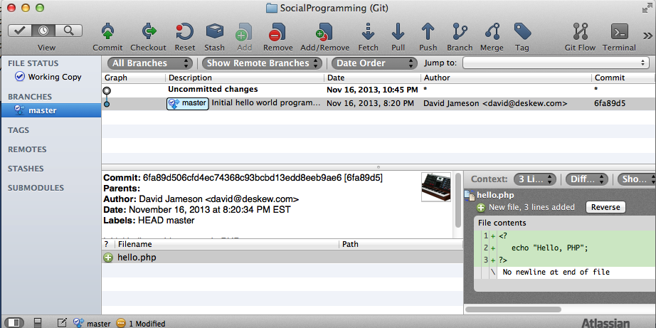
Two things happen
1) The history of the master branch indicates that something has changed

Slide 27
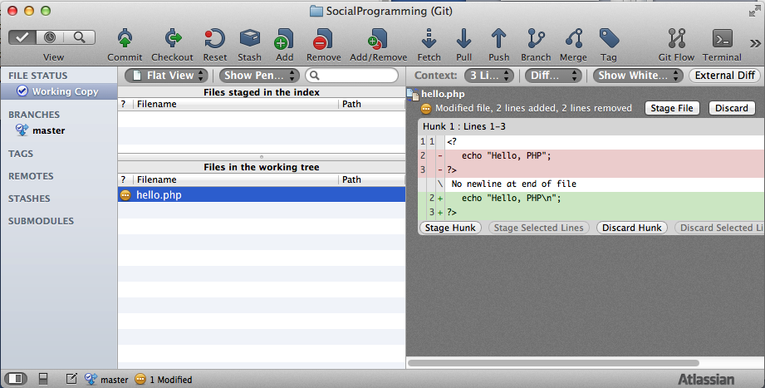
Two things happen
2) We can see the change when we look at the Working Copy

Slide 28
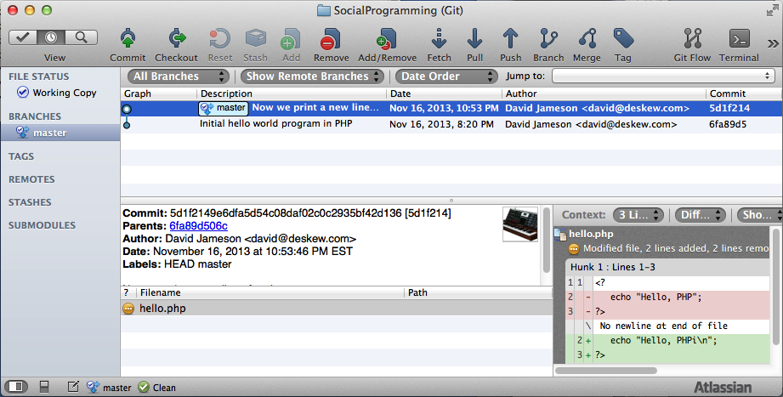
After committing the new change
Notes:
We commit the new change and now we can see some history

Slide 29
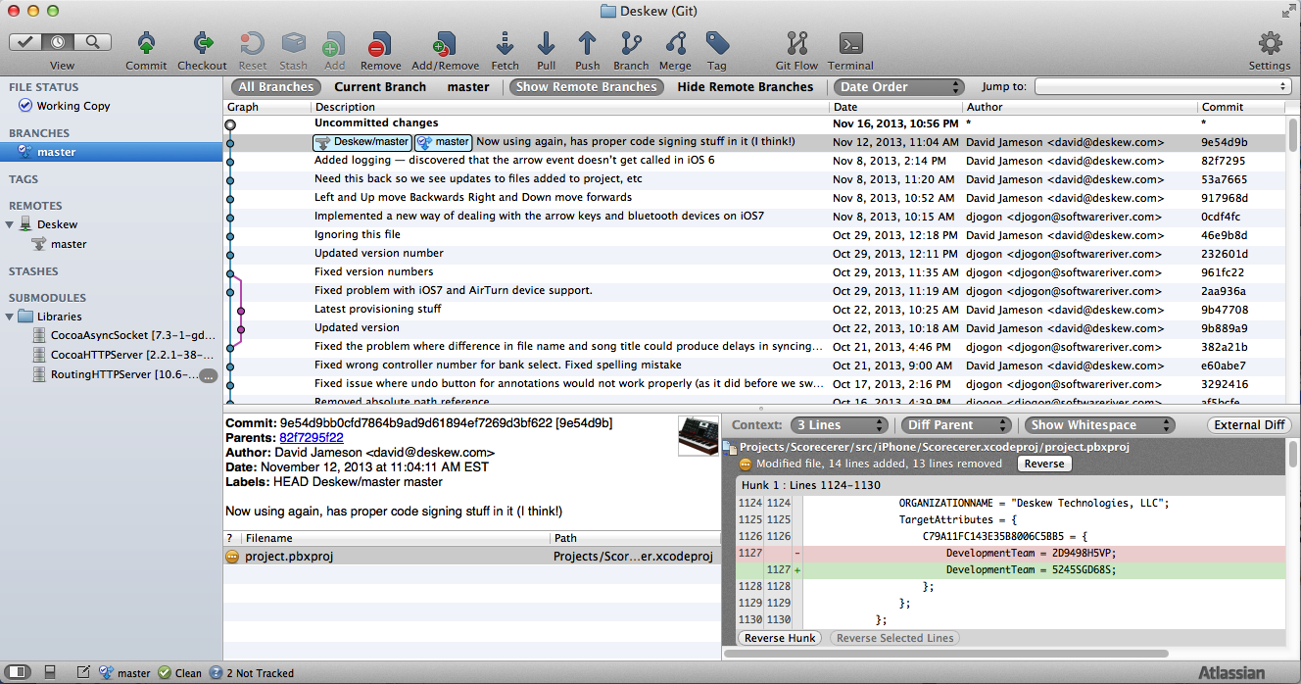
History of change
Notes:
This is an example from my own company.

Slide 30
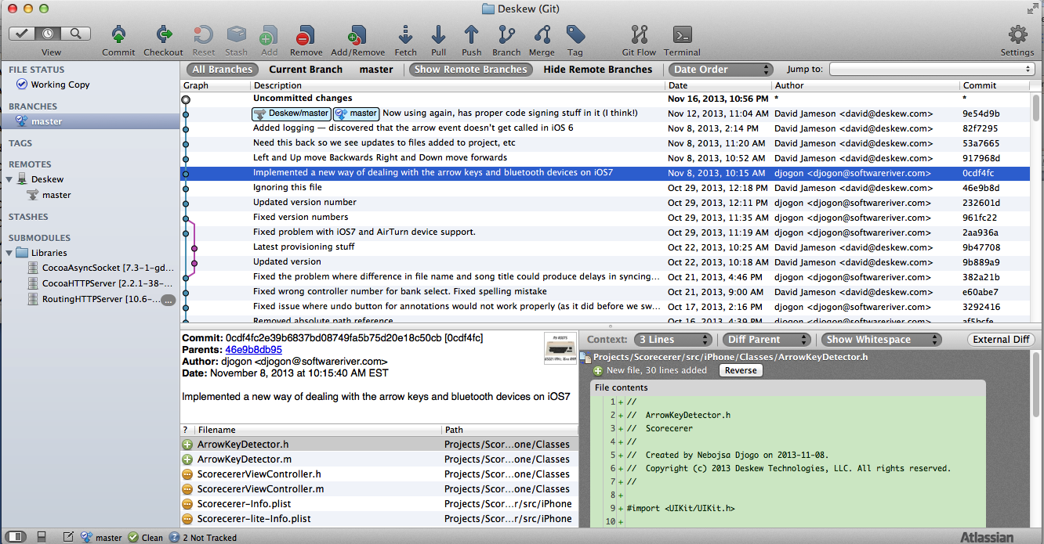
Notes:
Click on any commit to see what happened at that point. By the way, what’s that purple stuff?

Slide 31
Branching
Work on specific features without impacting the master files
Branch and merge often, even in a single day
Very lightweight mechanism
Experiment with ideas without losing your main work
Facilitate interruptions to fix production issues

Slide 32
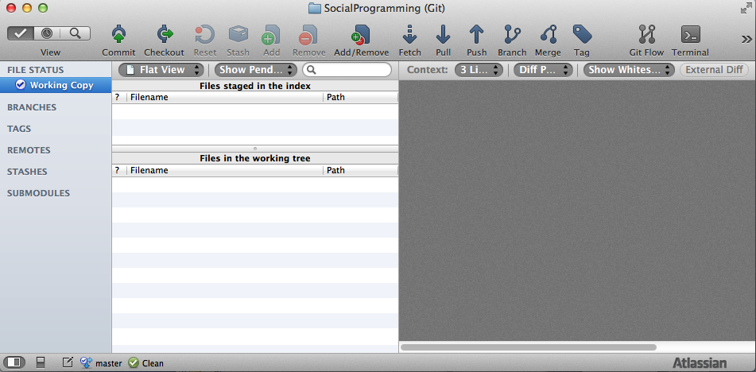
Hotfix
We need to multiply some numbers
Notes:
We could only do addition before

Slide 33
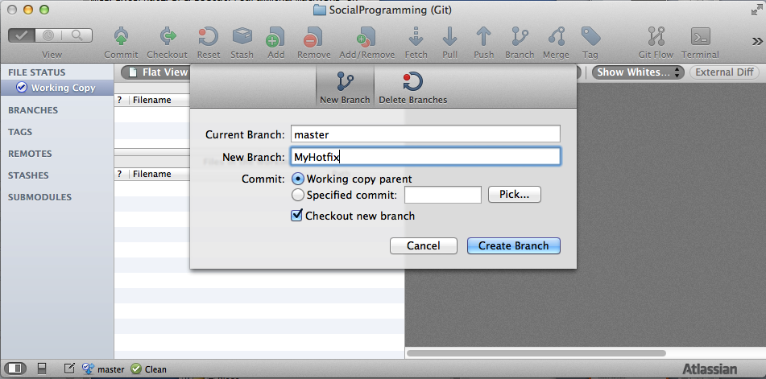
After making sure our working copy is clean, create a new branch

Slide 34
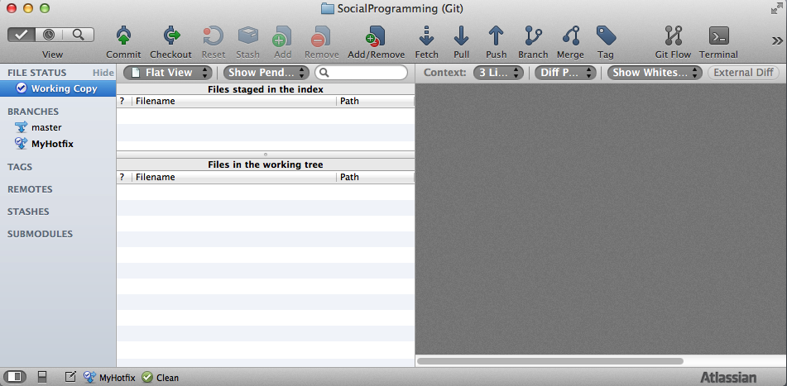
Notes:
MyHotfix is highlighted

Slide 35
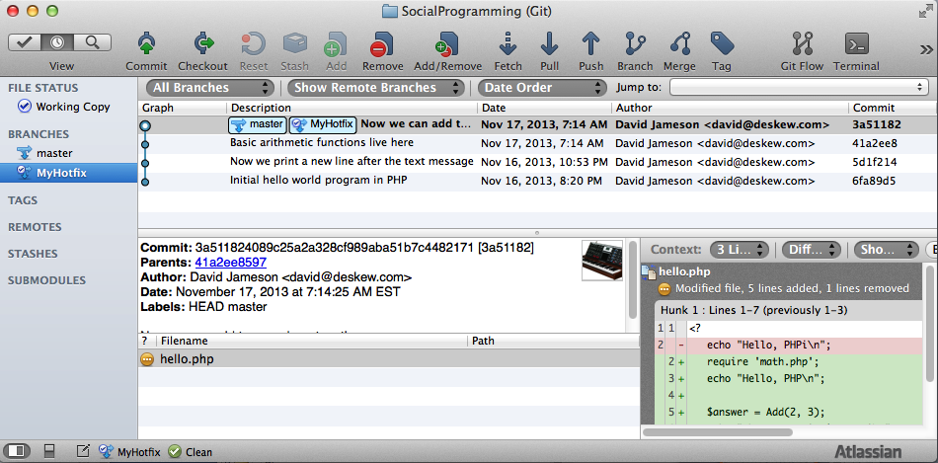
Notes:
Contents (history) are identical to the original at this point

Slide 36
Modify our math library to include the multiply function
Add a test file to test that it works

Slide 37
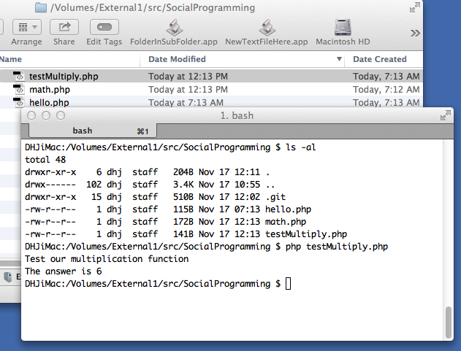

Slide 38
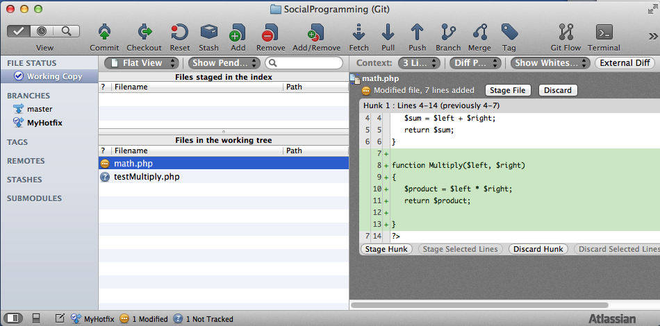
New and modified files are displayed in the Working Copy

Slide 39
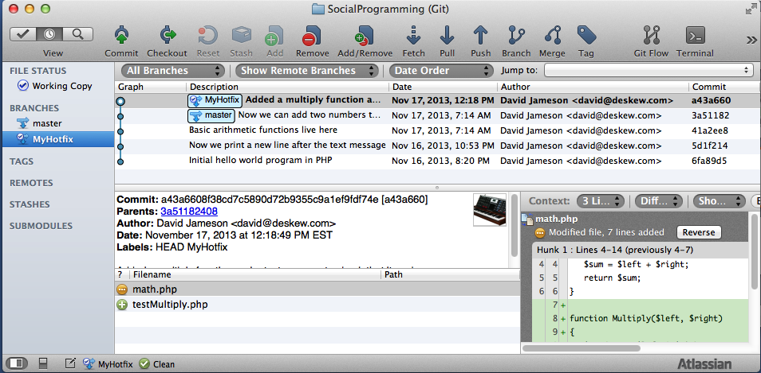
After staging and committing
Notes:
After staging and committing

Slide 40
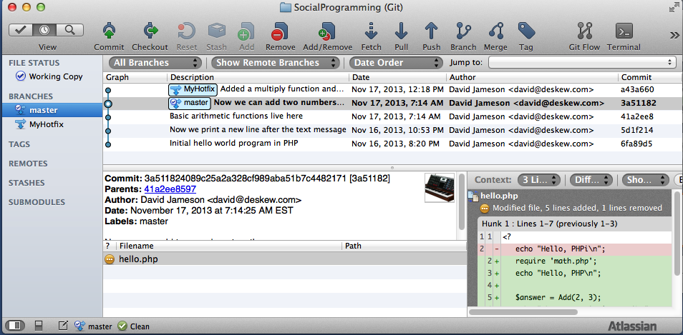
Now checkout the ‘master’ again
Notes:
Double-click on the desired commit. You’ll get a warning and you need to be aware of any locally changed files

Slide 41
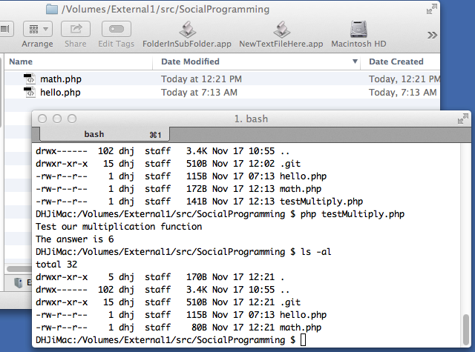
testMultiply is gone, math.php only has the Addition function again
Notes:
But don’t worry --- the other change is still in the repo --- nothing is actually lost

Slide 42
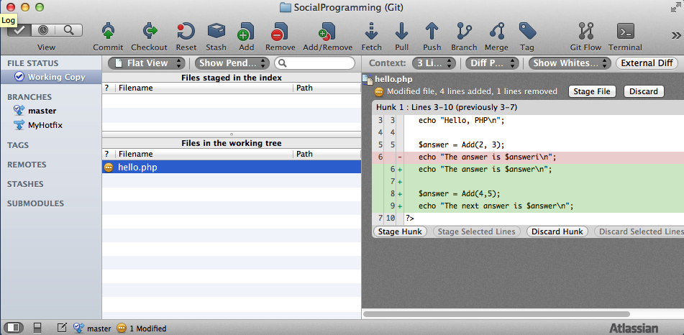
Multiple branches
Back in the master, we make a new change to our “hello” program
Notes:
We want to do two additions now.

Slide 43
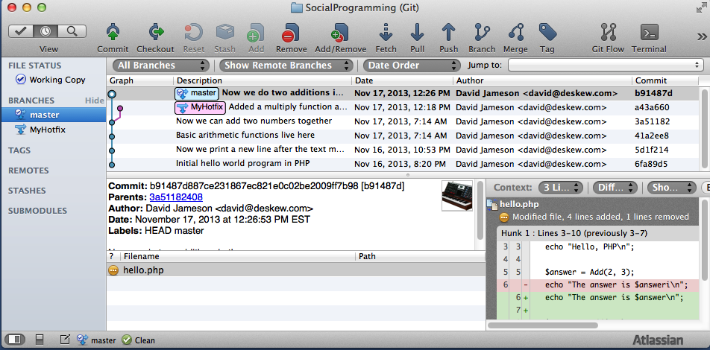
Commit the change.
Now there are two separate branches in the system
Notes:
Continue with your original work and leave the other branch alone for now
Perhaps checkout the other branch again to make a fix.

Slide 44
Merging
You have finished working on your original task and now you’d like to pull in the changes you made for the hotfix so you can use that new feature (multiplication!) going forward in your main project

Slide 45
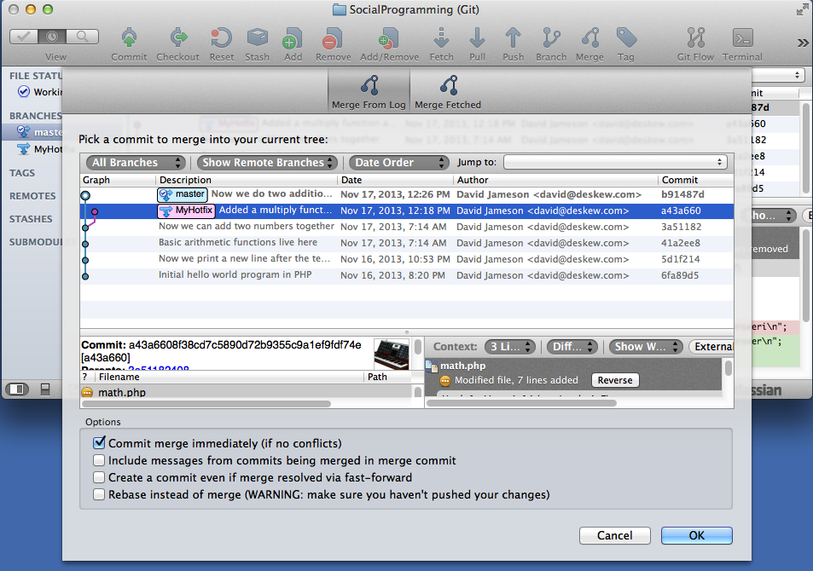
Notes:
The master is the current tree (branch) so we select the tip (HEAD) of the MyHotfix branch

Slide 46
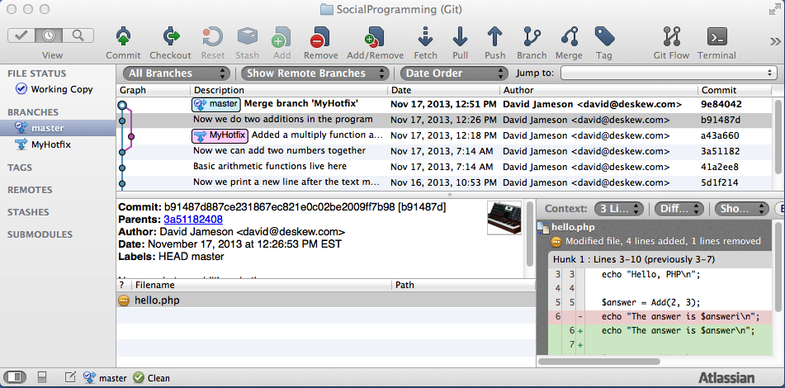
Now we’re back on the main branch again

Slide 47
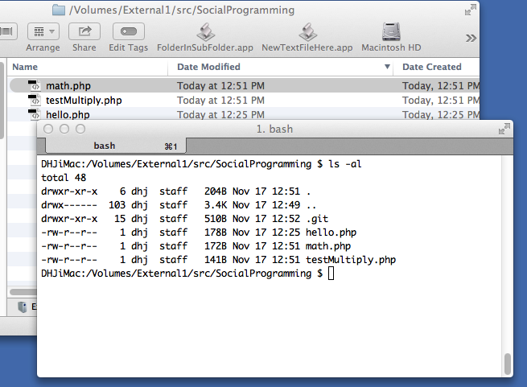
Notes:
We now have all the files again, including that testMultiply

Slide 48
This works exactly the same way if you’re merging code from another team member

Slide 49
Sharing repositories
In a team environment, there will often be a “bare” repo created on a server
Developers will do their own local commits and then push their changes to the server
Other developers can then pull those changes and merge them with their own local changes.
That merged pull would then be pushed right back out again

Slide 50
Bisect
Scenario
Development taking place for a long time
Lots of code changes over time
You suddenly discover that some feature is no longer working but you don’t know what caused it to break
Solution
Find a commit where feature works
Find a commit where feature fails
Leverage binary search to find root cause
Leverages easy replacement of working copy

Slide 51
Pull vs. Fetch
When you pull from a remote, changed code is merged into your existing code base
What if you want to see what has changed before you do this
Fetch pulls the remote changes but does NOT integrate them into your own history

Slide 52
GitFlow
Development workflow created by Vincent Driessen
Leverages lightweight branch/merge
Supports
Parallel development
Teamwork
Release testing
Out of band hotfixes
http://nvie.com/posts/a-successful-git-branching-model/
http://datasift.github.io/gitflow/IntroducingGitFlow.html

Slide 53
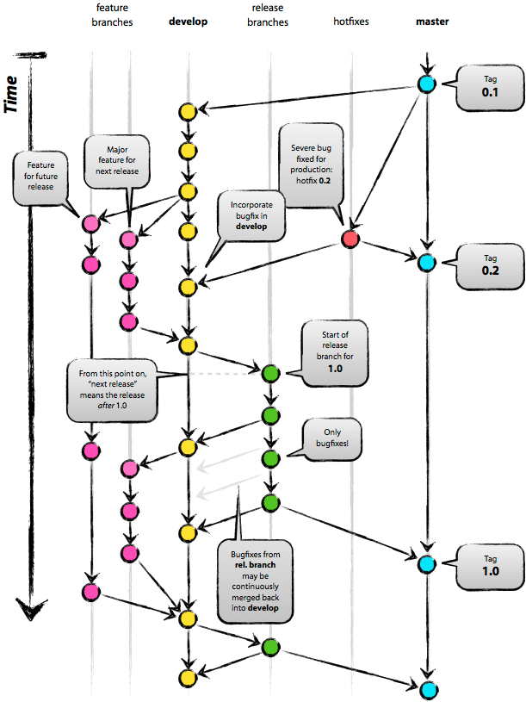

Slide 54
Conclusion
Use it for all your creative work
Commit often
Commit comments are very important
Ideally, have access to remote repo for backup
Don’t be afraid to experiment

